Slide 1
Domestic Relations eFiling
Attorney and Paralegal
Training Overview

Slide 2
How does it work?
All filings will come to the Court through eFiling – no exceptions.
You can submit pleadings for filing everyday of the week, at any time (24/7).
Filing fees/costs are paid through the eFiling System.
All originals shall be maintained by counsel/self-represented parties.

Slide 3
What’s different? Generally
All attorneys will be served through the eFiling System.
Each filing will be automatically forwarded to the appropriate staff member.
Judge and Magistrate signatures are obtained through eFiling.

Slide 4
What’s different? Generally (continued)
We now require a 3-inch margin on the top of the first page of any filed document that we control (excludes state/federal forms).
This area will be used for the clerk’s time-stamp and signatures of Judges/Magistrates. Mont. D.R. Rule 4.05(F)

Slide 5
What’s different? Generally (continued)
Domestic Violence Cases – filling out the petition and other forms is done on a computer and filed through the DV Coordinator.
Computers in our lobby will include a “chat”
feature for filers.
An option to start the process offsite will
be available with a 3-business day deadline
to complete the process at Court.

Slide 6
What’s different? Generally (continued)
The system tracks all submissions, so nothing can be “lost” for long.

Slide 7
eFiling Accounts
The Montgomery County Clerk of Courts controls the eFiling accounts.
Each attorney is required to use the Court’s eFiling System and will need an account with a method of payment attached for clerk fees. GET ONE NOW.
Fees include a 3.0% convenience fee (“Conv. Fee”) added to all cases which is paid at the time of filing, along with the deposit. Mont. D.R. Rules 4.04 and 4.042
VLP will have an account with the assigned attorney as co-counsel.

Slide 8
Responsibility for Your Account
Mont. D.R. Rule 4.05(D):
1. Each attorney will have a confidential and unique electronic identifier to use the eFiling System and they will be responsible for the security and use of such identifier.
2. All eFiled documents shall be deemed to be made with the authorization of the account holder who is assigned the specific unique electronic identifier, unless account holder proves to the satisfaction of the Court, by clear and convincing evidence, that the contrary is demonstrated.

Slide 9
MONT. D.R. RULE 4.05(F) FORM OF DOCUMENTS:
A filed document shall not contain links to other documents or references to the CMS, unless they are incorporated into the filed documents. External links are prohibited.
Individual documents included in a submission shall not exceed 10 megabytes in size.
Any combination of documents eFiled in one submission shall not exceed 30 megabytes in size.

Slide 10
MONT. D.R. RULE 4.05(F) FORM OF DOCUMENTS: continued
Complaints, Petitions, Affidavits, Motions, Notices, and any documents signed by you or your client should be submitted to eFiling in PDF.
If the system rejects your submission as being the wrong format, change the format and resubmit.

Slide 11
MONT. D.R. RULE 4.05(F) FORM OF DOCUMENTS: continued
Proposed Decrees, Entries, and Orders can be submitted through eFiling in PDF or WORD, except Ex Parte Notices of Hearing, see slide 31.

Slide 12
OTHER NEW MONT. CO. RULES
Mont. D.R. Rule 4.05(I): Personal and Private Information in Documents Filed with the Clerk.
Mont. D.R. Rule 4.05(J): Exceptions to eFiling.
Mont. D.R. Rule 4.05(K): Collection of Filing Deposit And Fees.
Mont. D.R. Rule 4.05(L): Removal of Documents From Clerk’s Office.
Mont. D.R. Rule 4.051: Filing Sealed and In Camera Documents.

Slide 13
MONT. D.R. RULE 4.05(F) FORM OF DOCUMENTS: continued
4. Signatures: [If not filing in PDF]
a. Attorney/Filing Party Signature: eFiled documents that require the signature of the attorney or filing party shall be signed with a conformed signature of “/s/
name.” The correct format for an attorney’s conformed signature is as follows:
/s/Attorney Name
Attorney Name
Bar Number 1234567
Attorney for [Plaintiff/Defendant] NAME
ABC Law Firm
Address
Telephone
Fax and/or E-mail address

Slide 14
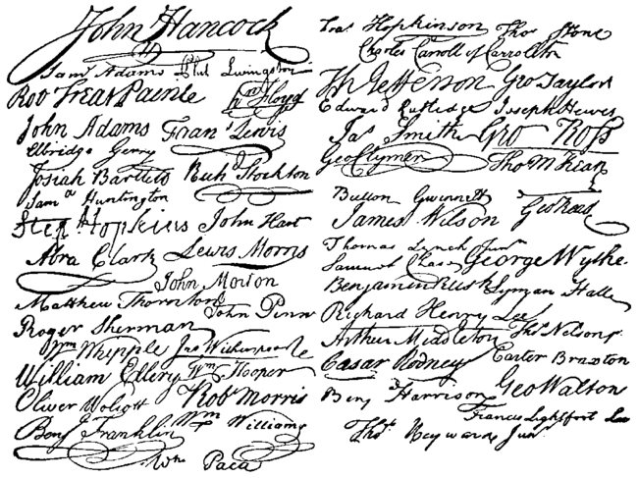
MONT. D.R. RULE 4.05(F) FORM OF DOCUMENTS: 4. Signatures (continued):
c. Multiple Signatures: When a stipulation or other document requires two or more signatures, the filer shall:
i. confirm that the content of the document is acceptable to all persons required to sign the document;
ii. indicate the agreement of other counsel or parties at the appropriate place in the document, usually on the signature line; and
iii. eFile the document, indicating the signatories, e.g., /s/ Jane Doe, etc.

Slide 15
MONT. D.R. RULE 4.05(F) FORM OF DOCUMENTS: 4. Signatures (continued):
d. Original Signatures: Documents requiring an original signature, such as an affidavit or other notarized documents should be eFiled as a .pdf.
i. The filer shall maintain the signed document in the filer’s records and have
it available for production upon request of the Court.
ii. The signed document shall be maintained until the case is closed and the
time for appeal has expired or the appeals have been heard or denied and
all opportunities for post judgment relief are exhausted.

Slide 16
MONT. D.R. RULE 4.05(F) FORM OF DOCUMENTS: 4. Signatures (continued):
e. Signature of Judge or Magistrate: eFiled documents may be signed by a Judge or Magistrate via a digitized image of his or her signature.
All orders, decrees, judgments and other documents signed in this manner shall have the same force and effect as if the Judge or Magistrate had affixed his or her signature to a paper copy of the order and journalized it.

Slide 17
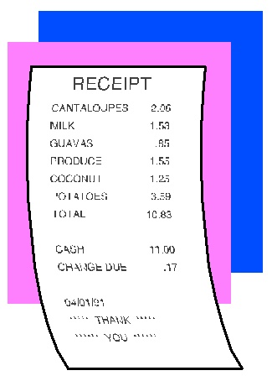
MONT. D.R. RULE 4.05(G) TIME, EFFECT AND PROCESS OF eFILING:
Receipt: Upon receipt, the eFiling system shall issue a confirmation that the submission has been received. The confirmation shall include the date and time of receipt and serve as proof of receipt.

Slide 18
MONT. D.R. RULE 4.05(G) TIME, EFFECT AND PROCESS OF eFILING:
3. Clerk Review: After Clerk Review, a filer will receive notification from the Clerk that the submission has been accepted or rejected by the Clerk.
a. If the submission is rejected, the document shall not become part of the Court record and the filer shall be required to re-submit the document to meet the requirements. The re-submitted document shall receive a new submission date and time.
b. If the submission is accepted, the document shall be docketed and filed as of the date and time submitted.

Slide 19
MONT. D.R. RULE 4.05(G) TIME, EFFECT AND PROCESS OF eFILING:
Official Time Stamp: The submission receives an electronic stamp that includes the date and time that the filer submitted the document to the Court’s eFile system as well as the unique confirmation number of the filing.
System Errors: If a submission is not received by the Court because of a System Error, the Court may, upon satisfactory proof, enter an order permitting the document to be filed nunc pro tunc to the date it was submitted.

Slide 20
MONT. D.R. RULE 4.05(H)(a)(i) & (ii) SERVICE:
WHAT’S NEW
Documents Filed Subsequent to Complaint:
The eFile system generates a Notification of Electronic Filing (NEF) sent to the filer and any other attorney or party who is a registered user of the eFile system.
The Notification of Electronic Filing constitutes service under Civ. R. 5.

Slide 21
MONT. D.R. RULE 4.05(H)(a)(iii) SERVICE:
NOT NEW
Documents Filed Subsequent to Complaint:
The filer shall serve a paper copy of the document on all Self- Represented parties who are not registered users of the Court’s eFile system in accordance with Civ. R. 5.

Slide 22
MONT. D.R. RULE 4.05(H)(3)(B)(i) SERVICE: WHAT’S NEW
Court generated documents:
A Notification of Electronic Filing will be sent to all eFiling users for all entries and orders signed by the Judge or Magistrate and notices filed by Court staff.
This Notification of Electronic Filing (NEF) shall constitute service under Civ. R. 5 for all Electronic Filing users. The Clerk will serve a paper copy of the document on all Self-Represented parties who are not registered users of the Court’s eFile system in accordance with Civ. R. 5

Slide 23
MONT. D.R. RULE 4.05(H)(3)(b)(ii) SERVICE: WHAT’S NEW
Party generated proposed orders:
After the order or entry has been signed and filed, the attorney/party who submitted the proposed entry/order, not the Court or Clerk, shall serve it on all Self-Represented parties who are not registered users of the Court’s eFile system.

Slide 24
MONT. D.R. RULE 4.05(H)(3)(c)(i) & (ii) SERVICE: WHAT’S NEW
Certificate of Service:
“I hereby certify that on [date] this document was eFiled via the Court’s eFile system which shall send notifications of this filing to the following: [list parties or their counsel who are registered users of the Court’s eFile system].”
and/or
“I hereby certify that on [date] I served this document in accordance with [Civ. R. 5] on the following: [list Self Represented parties with addresses who are not registered users of the Court’s eFile system].”

Slide 25
MONT. D.R. RULE 4.05(H)(4)(a) SERVICE: WHAT’S NEW
Service Date and Time to Respond or Act:
For Self Represented parties who are registered users of the Court’s eFile
system and counsel of record, service shall be deemed complete at the time
the Notification of Electronic Filing is generated by the Court’s eFile system.
The NEF is generated when the clerk’s staff approves the filing. Documents filed later in the day may be served on the next business day.

Slide 26
MONT. D.R. RULE 4.05(H)(4)(b) SERVICE: WHAT’S NEW
Service Date and Time to Respond or Act (continued):
The time to respond to the served documents or perform any right, duty, or act shall be strictly governed by the applicable Rules of the Court.
Self-Represented parties who are not registered users of the Court’s eFile system and who are served by regular U.S. mail shall receive a three-day extension of time to respond or perform any right, duty, or act.
Parties and counsel of record served via eService are not entitled to the three-day extension.

Slide 27
MONT. D.R. RULE 4.05(H)(5) SERVICE: WHAT’S NEW
Failure of eService:
If the eFile system fails to generate the Notification of Electronic Filing (NEF), the party to be served may be entitled to an order extending the date for any response or the period within which any right, duty or act must be performed.

Slide 28
Questionnaires
There will no longer be paper Divorce Questionnaires.
Primary Parties will be required to answer a series of questions as part of the case initiation process before they file anything which will generate a Court Questionnaire and a Primary Party Questionnaire which are saved in our system. MAKE SURE ALL THE QUESTIONS ARE ANSWERED, especially the secondary parties’ date of birth and social security number.
The Primary Party Questionnaire is on our Website so you can have your client fill it out before you start case initiation.
Defendants shall submit a Secondary Party Questionnaire when filing an answer or Affidavit of Financial Disclosure. The Secondary Party Questionnaire is available on our Website.

Slide 29
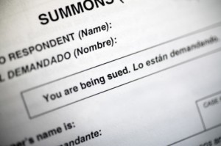
MONT. D.R. Rule 4.13 SERVICE OF PROCESS AND SPECIAL PROCESS SERVERS:
PROCESS SERVERS will be required to have their own eFiling Account to receive pleadings to be served and return service via eFiling. Process servers should contact the Clerk’s Office to set up an account.

Slide 30
MONT. D.R. RULE 4.15 ORAL HEARINGS ON TEMPORARY ORDER
Only change is that Requests for Oral Hearings
no longer require a Notice of Hearing.

Slide 31
MONT. D.R. RULE 4.17 TEMPORARY RESTRAINING ORDERS AND EX PARTE ORDERS
Temporary Restraining Orders (TRO) – Attorneys prepare both motion and proposed order.
(C) Ex Parte Custody & Parenting Time Issues:
The Notice of Hearing (Word) of such a hearing shall include the following language:
This matter is hereby set for hearing on ___________ at _______am/pm before Judge/Magistrate ________________ to determine whether the ex parte order granted _______________ shall remain in effect. Both parties, with or without counsel, shall be present on the above date at the second floor of the Dayton-Montgomery County Courts Buildings, 301 W. Third Street, Dayton, Ohio.

Slide 32
MONT. D.R. RULE 4.20 CONTINUANCES Change to Procedure
Motions For Continuance no longer require a proposed entry.
Court staff will prepare an Entry Denying or Granting which will be filed without a new hearing date.
The time-stamped Entry Denying is delivered to:
Attorneys on the case via eService.
Self-represented parties via U.S. Mail.

Slide 33
MONT. D.R. RULE 4.20 CONTINUANCES Change to Procedure (continued)
The time-stamped Entry Granting is delivered to:
Attorneys on the case by eService.
Self-represented parties by U.S. Mail.
Assignment to schedule a new date. Assignment will prepare and file a Notice of Hearing.
The requesting party is responsible for advising self-represented parties of the continuance.

Slide 34
MONT. D.R. RULE 4.23 SUBMITTING FINAL JUDGMENTS AND DECREES
Non-contested matters.
Counsel shall bring the final judgment and decree to the final hearing for all dissolutions and any non-contested divorces, legal separations, and annulments. After the hearing, counsel shall ensure the decree conforms to any changes discussed and submit it into the eFiling System along with the MC SEA New Case Number worksheet (submitted separately).

Slide 35
DISSOLUTION SEPARATION AGREEMENTS AND SHARED PARENTING PLANS
Because these documents are attached to initial pleadings and final decrees, each will need to be filed separately for later attachment to the decrees. Continue to attach these documents to your initial pleadings but also file them separately.
Make sure the parties’ full names are on the document.

Slide 36
DIVORCE AND SEPARATION AGREEMENTS
In a divorce case, if the parties enter into a Separation Agreement, attach it to the Final Decree of Divorce when you submit it into eFiling.
It does not need to be submitted separately.

Slide 37
MONT. D.R. RULE 4.41 POST-DECREE MOTIONS
NOTICE OF HEARING WILL BE PREPARED BY ASSIGNMENT
Non-financial post-decree motions will be screened by the Mediation Department and sent to Assignment for a hearing date.
Financial post-decree motions are not screened for mediation and are sent directly to Assignment to set a hearing date.
If you have a multiple branch motion – decide if you want mediation or not -- pick the closest option for type of motion.

Slide 38
MONT. D.R. RULE 4.41(E)(3) POST-DECREE MOTIONS
Motion For Relief Under Civil Rule 60 or R.C. 3119.961
Motions for Relief from Judgment or Order under Civ. R. 60(A), 60(B) and R.C. 3119.961 shall be filed separately and shall not be included in a multibranch motion.

Slide 39
MONT. D.R. RULE 4.42(C) MOTIONS TO SHOW CAUSE (CONTEMPT)
The Court will prepare the
“Order to Show Cause”
So you do not need to
submit one.

Slide 40
What’s different for Self-Represented Parties (not much)
Self-represented parties will still have their documents approved by Compliance.
There are computers outside Compliance for self-represented parties to complete the Primary Party questions for the Questionnaires.
Once the self-represented parties complete the questions, they will take their documents to the Clerk’s staff, who will enter them into the eFile system.

Slide 41
TROUBLESHOOTING and QUESTIONS
DR COURT:
Magistrate Barbara Reno: renob@mcohio.org
Court Administrator Jennifer Petrella: PetrellaJ@mcohio.org
Clerk’s Office:
Sharon Harness
Assistant Chief Deputy
Montgomery County Clerk of Courts
937-224-3875
Email: Harness@mcohio.org
Rachel Doyle
Assistant Chief Deputy
Montgomery County Clerk of Courts
(937) 496-7623 or (937) 496-7179
Email: DoyleR@mcohio.org

